Slide 1

DevFest
CheQ
Team : warmy
Notes:
Note:

Slide 2
DevFest
Introduction
Notes:
Note:

Slide 3
INTRODUCTION
DevFest
Each year
1
2
3
4
5
6
7
8
9
1
2
3
4
5
6
7
8
9
1
2
3
4
5
6
7
8
9
0
1
2
3
4
5
6
7
8
9
0
1
2
3
4
5
6
7
8
9
0
Death
Notes:
Note:
Some examples of random experiments are:
+Flipping a coin.
+Rolling dices.
You will start with these simple examples and build a basis of probability.

Slide 4
DevFest
What’s CheQ
Team : warmy
Notes:
Note:

Slide 5
What’s CheQ?
DevFest
CheQ is a smart safety system
- Danger situation
Notes:
Note:
Some examples of random experiments are:
+Flipping a coin.
+Rolling dices.
You will start with these simple examples and build a basis of probability.

Slide 6
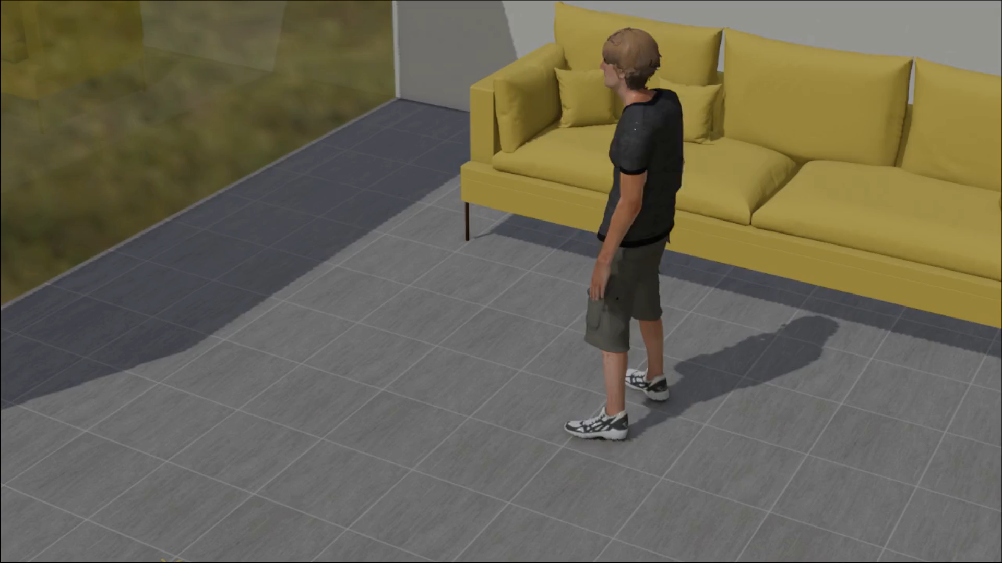
DevFest
Notes:
Note:
Some examples of random experiments are:
+Flipping a coin.
+Rolling dices.
You will start with these simple examples and build a basis of probability.

Slide 7
What’s CheQ?
DevFest
CheQ is a smart safety system
- Danger situation
- Normal situation
Notes:
Note:
Some examples of random experiments are:
+Flipping a coin.
+Rolling dices.
You will start with these simple examples and build a basis of probability.

Slide 8
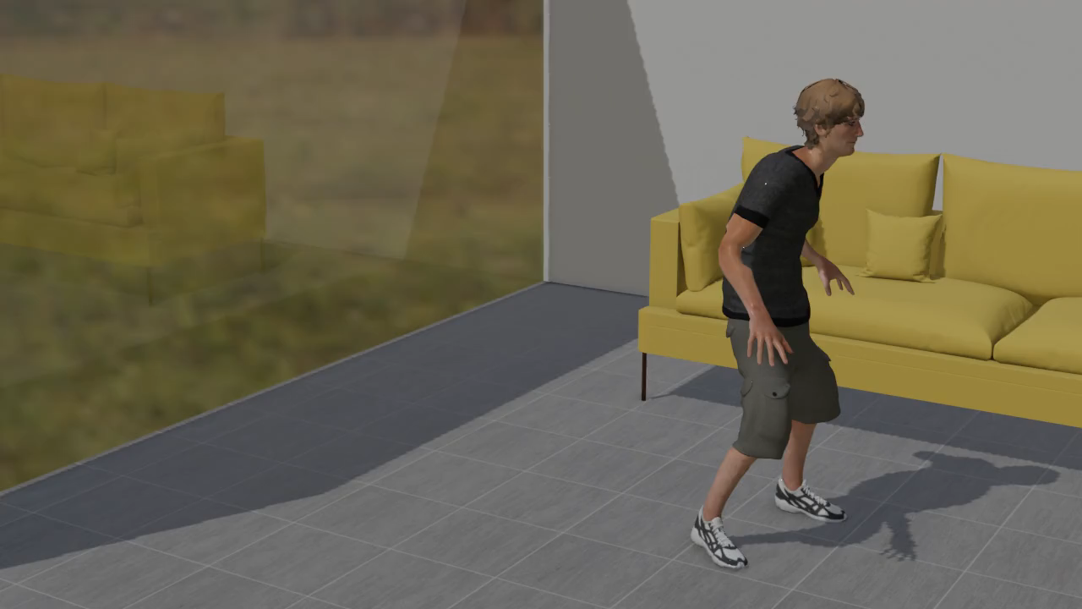
What’s CheQ
DevFest
Notes:
Note:
Some examples of random experiments are:
+Flipping a coin.
+Rolling dices.
You will start with these simple examples and build a basis of probability.

Slide 9

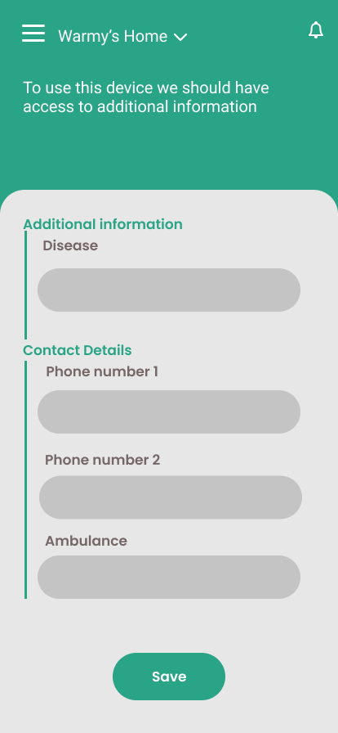
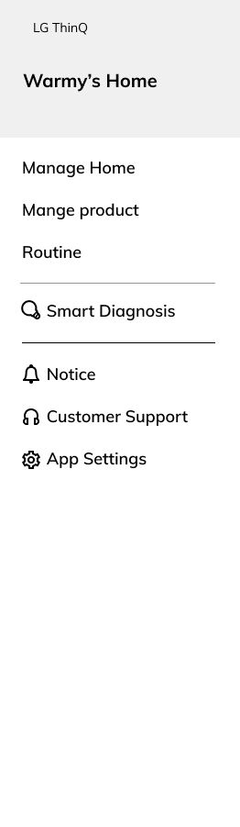
What’s CheQ
DevFest
Notes:
Note:
Some examples of random experiments are:
+Flipping a coin.
+Rolling dices.
You will start with these simple examples and build a basis of probability.

Slide 10
DevFest
Conclusion
Team : warmy
Notes:
Note:

Slide 11
Conclusion
DevFest
CheQ , Welcome to the new era of home safety
Notes:
Note:
Some examples of random experiments are:
+Flipping a coin.
+Rolling dices.
You will start with these simple examples and build a basis of probability.

Slide 12
DevFest
Thank You
Team : warmy
Notes:
Note:

